Slide 1


Jan. 10
Officer Cotter threatens Mr. Houston
January 10, 2007
Officer Cotter threatens Mr. Houston
January 2007

Slide 2
Jan. 10
Officer Cotter threatens Mr. Houston
January 11, 2007
Jan. 11
Mr. Houston is assaulted by Officers Cotter and Weiss, and is placed on suicide watch
Mr. Houston is assaulted by Officers Cotter and Weiss, and is placed on suicide watch
January 2007

Slide 3
Jan. 10
Officer Cotter threatens Mr. Houston
January 12, 2007
Jan. 11
Mr. Houston is assaulted by Officers Cotter and Weiss, and is placed on suicide watch
Officer Weiss observes Mr. Houston on suicide watch
Jan. 12
Officer Weiss observes Mr. Houston on suicide watch
1 day
January 2007

Slide 4


Jan. 16
Jan. 10
Dr. Troiano and Graziano determine that Mr. Houston is not suicidal and request his removal from suicide watch
Officer Cotter threatens Mr. Houston
January 16, 2007
Jan. 11
Mr. Houston is assaulted by Officers Cotter and Weiss, and is placed on suicide watch
Dr. Troiano and Graziano determine that Mr. Houston is not suicidal and request his removal from suicide watch
Jan. 12
Officer Weiss observes Mr. Houston on suicide watch
1 day
5 days
January 2007

Slide 5
Jan. 16
Jan. 10
Dr. Troiano and Graziano determine that Mr. Houston is not suicidal and request his removal from suicide watch
Officer Cotter threatens Mr. Houston
January 21, 2007
Jan. 21
Jan. 11
Nurse Frith sees Mr. Houston; calls classifications officers regarding the removal requests
Mr. Houston is assaulted by Officers Cotter and Weiss, and is placed on suicide watch
Nurse Frith sees Mr. Houston; calls classifications officers regarding the removal requests
Jan. 12
Officer Weiss observes Mr. Houston on suicide watch
10 days
5 days
January 2007

Slide 6
Jan. 16
Jan. 10
Dr. Troiano and Graziano determine that Mr. Houston is not suicidal and request his removal from suicide watch
Officer Cotter threatens Mr. Houston
January 24, 2007
Jan. 21
Jan. 11
Nurse Frith sees Mr. Houston; calls classifications officers regarding the removal requests
Mr. Houston is assaulted by Officers Cotter and Weiss, and is placed on suicide watch
Dr. Troiano and Graziano again request that Mr. Houston be removed from suicide watch
Jan. 24
Jan. 12
Dr. Troiano and Graziano again request that Mr. Houston be removed from suicide watch
Officer Weiss observes Mr. Houston on suicide watch
10 days
14 days
January 2007

Slide 7


Jan. 16
Jan. 10
Dr. Troiano and Graziano determine that Mr. Houston is not suicidal and request his removal from suicide watch
Officer Cotter threatens Mr. Houston
January 24, 2007
Jan. 21
Jan. 11
Nurse Frith sees Mr. Houston; calls classifications officers regarding the removal requests
Mr. Houston is assaulted by Officers Cotter and Weiss, and is placed on suicide watch
Later that day, Mr. Houston is removed from suicide watch
Jan. 24
Jan. 12
Dr. Troiano and Graziano again request that Mr. Houston be removed from suicide watch
Officer Weiss observes Mr. Houston on suicide watch
Jan. 24
Later that day, Mr. Houston is removed from suicide watch
Mr. Houston on suicide watch: 14 days
14 days
January 2007

Slide 8
Evidence That Suicide Watch is Used as Punishment
Dr. Thomas A. Troiano, SCCF’s staff psychiatrist, admitted that corrections officers at SCCF use suicide watch as punishment.
Mr. Jorge Baez, a statistical expert, concluded that inmates from disciplinary housing on suicide watch stayed almost four times as long as inmates from non-disciplinary housing.
Mr. Toni V. Bair, a corrections expert, testified that Mr. Houston was kept on suicide watch as punishment.
Inmates cannot file grievances to challenge their placement on suicide watch, even when corrections officers overrule mental health professionals’ removal recommendations.

Slide 9
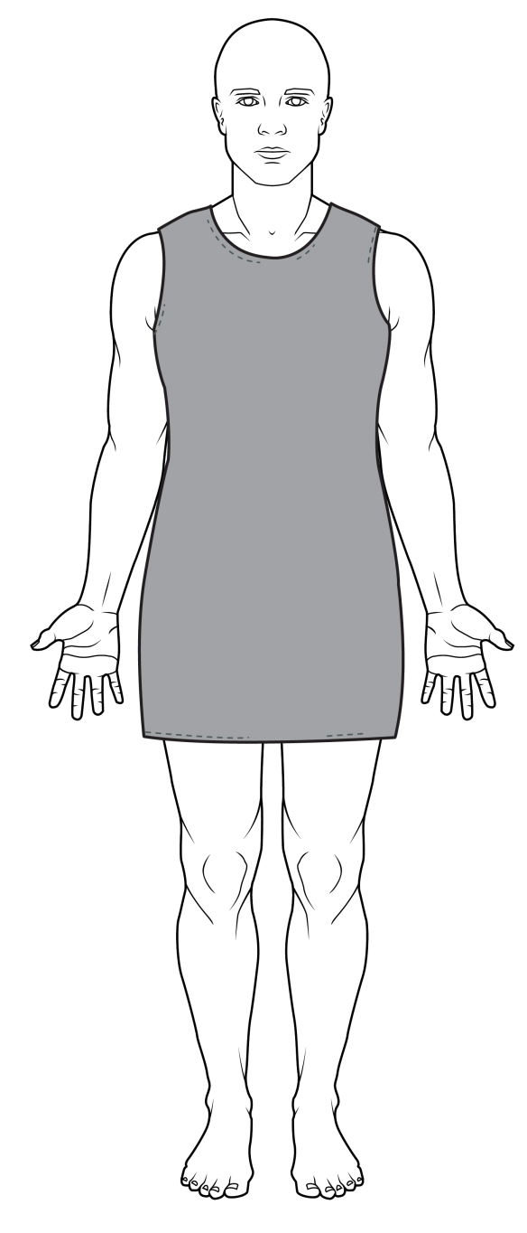
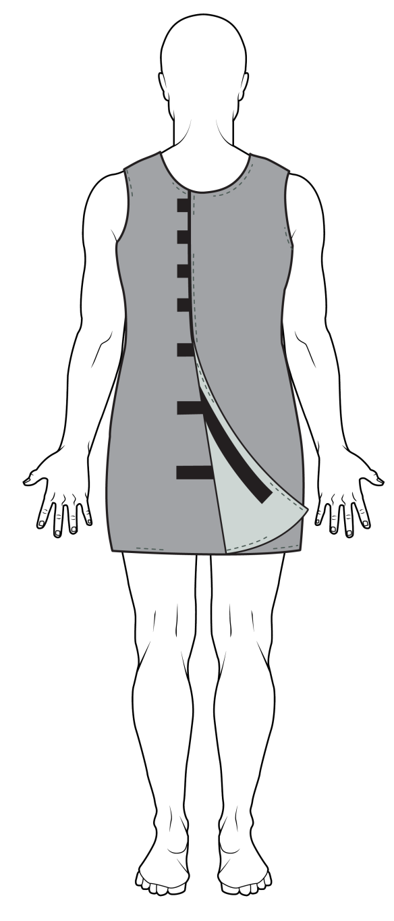
Conditions of Suicide Watch: Suicide Smock/“Dress”
Heavy, coarse material; unable to be torn
Velcro closures
No underwear
Short, dress-like appearance
No socks

Slide 10
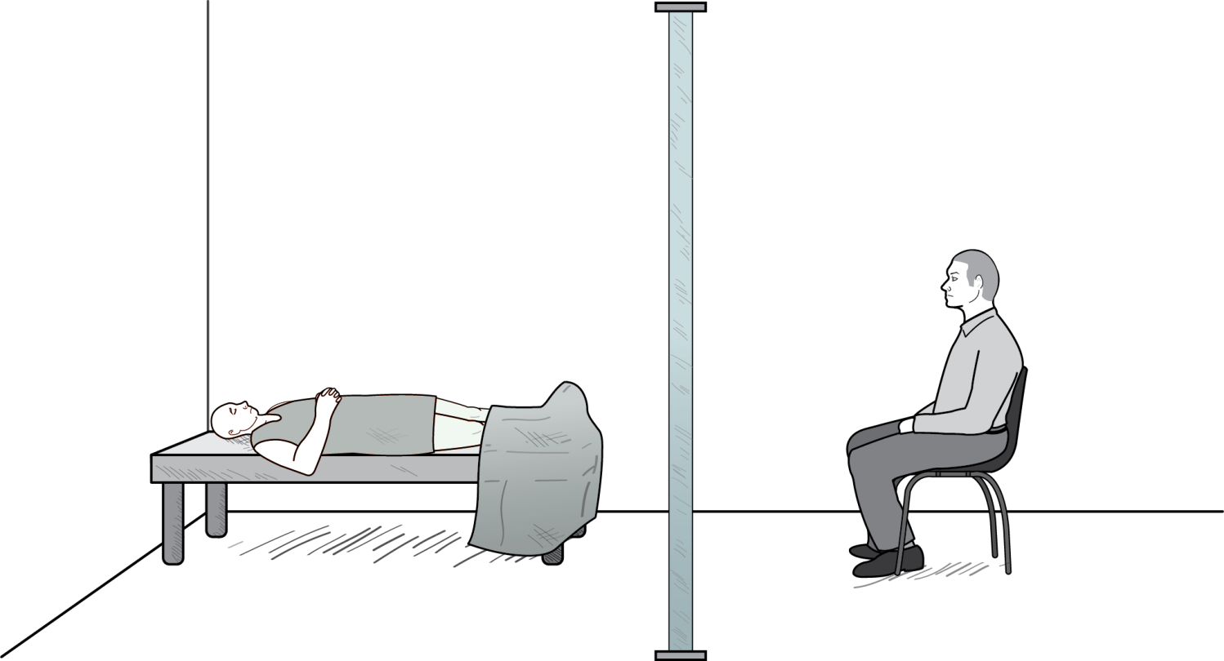
Conditions of Suicide Watch: Stripped Cell
See-through plexiglass wall
“Suicide blanket”
Bare mattress

Slide 11
Conditions of Suicide Watch: Constant Observation
See-through plexiglass wall
Officer
on-duty

Slide 12
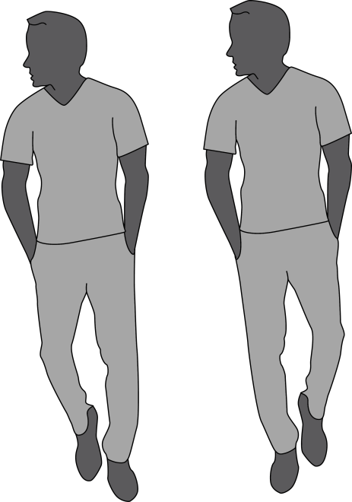


Conditions of Suicide Watch: Stigma & Humiliation
See-through plexiglass wall
Other inmates

Slide 13
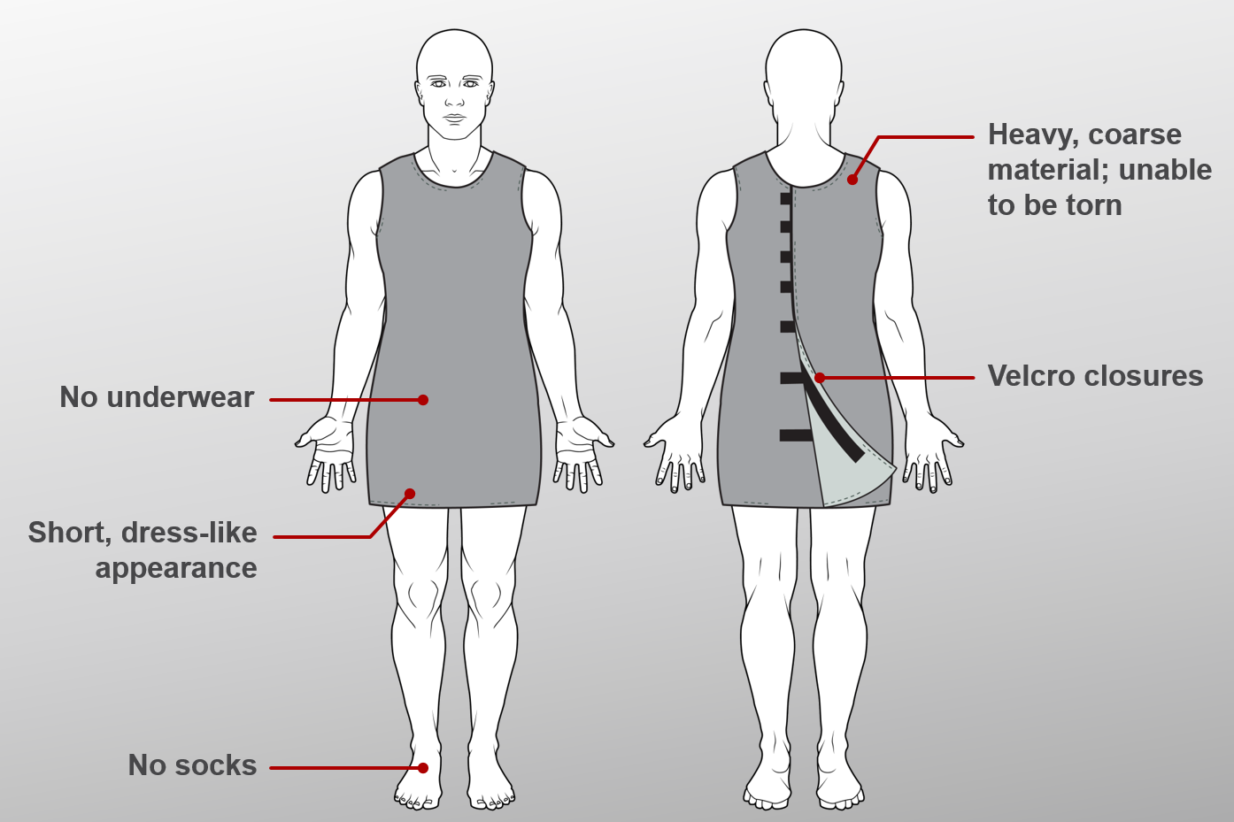
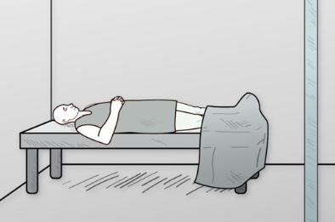
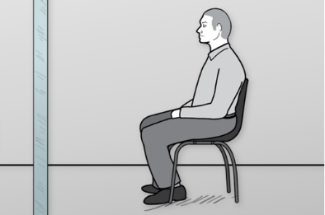
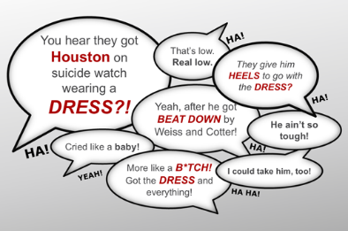
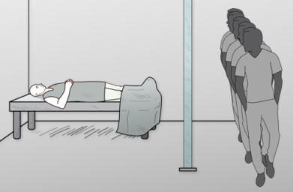
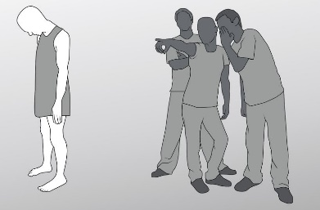
In Summation: Conditions of Suicide Watch
Suicide Smock
Stripped Cell
Constant Observation
Stigma & Humiliation
A.K.A. “suicide dress” or “suicide skirt”
Heavy, coarse material
Unable to be torn
Short, dress-like
Not allowed to wear socks or underwear
Velcro closures
Small cell
Bare, sheet-less mattress with only a “suicide blanket” (same material as “suicide smock”)
Plexiglass wall for constant observation by correction officer
Round-the-clock observation by corrections officer in front of plexiglass cell
No privacy
Within 24 hours of placement on suicide watch, Mr. Houston was observed by Officer Weiss (who attacked him a day before)
Ridicule for being sent to suicide watch, wearing the ‘dress’
Inmates on suicide watch are looked down upon, considered among the lowest classes of inmates
Potential for threats or attacks

Slide 14


Backgrounds of Classifications Officers vs. Mental Health/Medical Professionals
Officers Cotter & Weiss
Corrections Officers
Dr. Thomas A. Troiano
Staff psychiatrist
James Graziano,
LCSW-R
Social worker
Nurse Frith
Corrections Officers at SCCF | Medical doctor specializing in adult psychiatry; employed as staff psychiatrist at SCCF | Licensed clinical social worker specializing in diagnosing mental and behavioral disorders | Nurse practitioner specializing in psychiatric and mental health issues
No formal medical training/degrees | M.D. from New York Medical College, 1970 | M.A. in social work from Stony Brook, 1993
No formal training on how to interview inmates to determine if they are at risk of suicide | Over 30 years of experience as psychiatrist | Over 20 years of experience in mental health field
No periodic post-Academy training on suicide prevention | Residency in general psychiatry at Metropolitan Hospital in New York City, 1970-74

