Slide 1
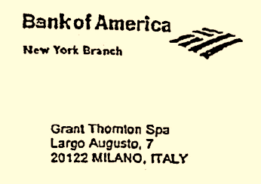
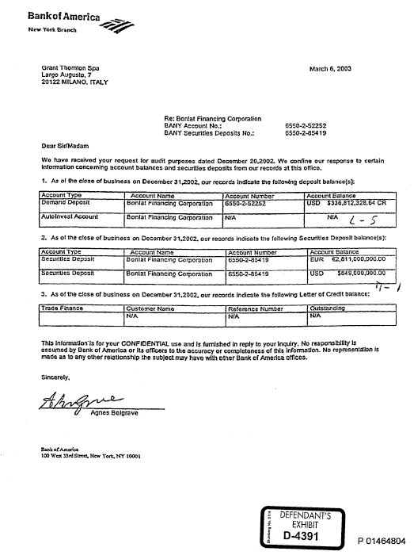
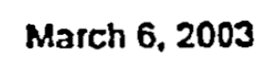
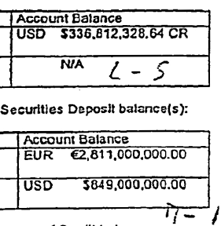
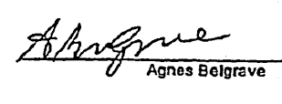
Paramalat’s Brazen Fraud
Fake Logo
Addressed to Auditors
$336 Million
in Cash
Text Typed in by Parmalat
€2.8 Billion
in Securities Account
$849 Million
in Securities Account
Fake Signature

