Slide 1
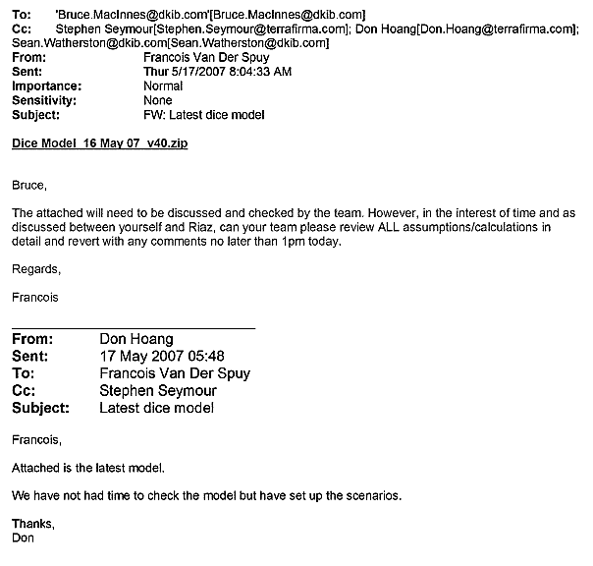
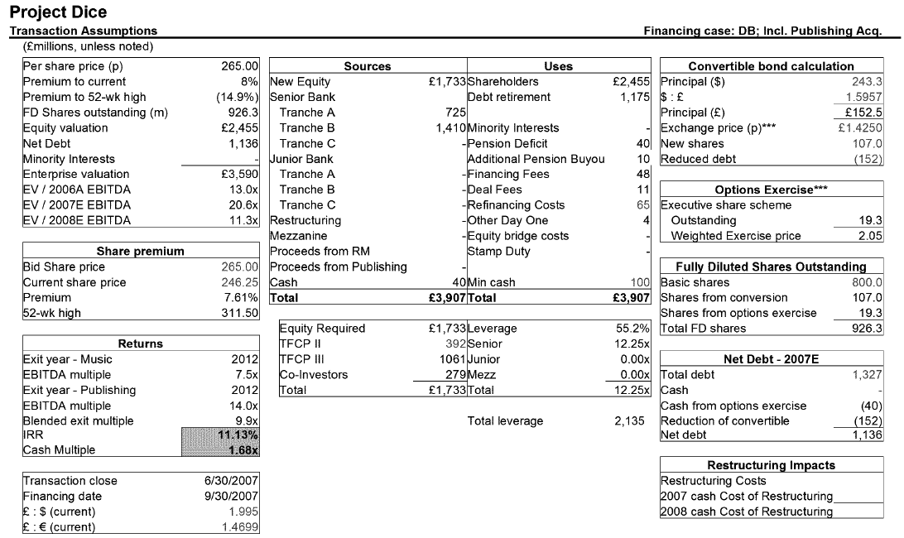
Terra Firma Was Consistently Targeting a Bid Price of 265p – May 17
Sunday | Monday | Tuesday | Wednesday | Thursday | Friday | Saturday
 |  | 1 | 2 | 3 | 4 | 5
6 | 7 | 8 | 9 | 10 | 11 | 12
13 | 14 | 15 | 16 | 17 | 18 | 19
20 | 21 | 22 | 23 | 24 | 25 | 26
27 | 28 | 29 | 30 | 31
May 2007
Bid Price: 265p
Bid Price: 265p
Bid Price: 265p
17
Bid Price: 265p
Bid Price: 265p
Bid Price: 265p
Bid Price: 265p

Slide 2
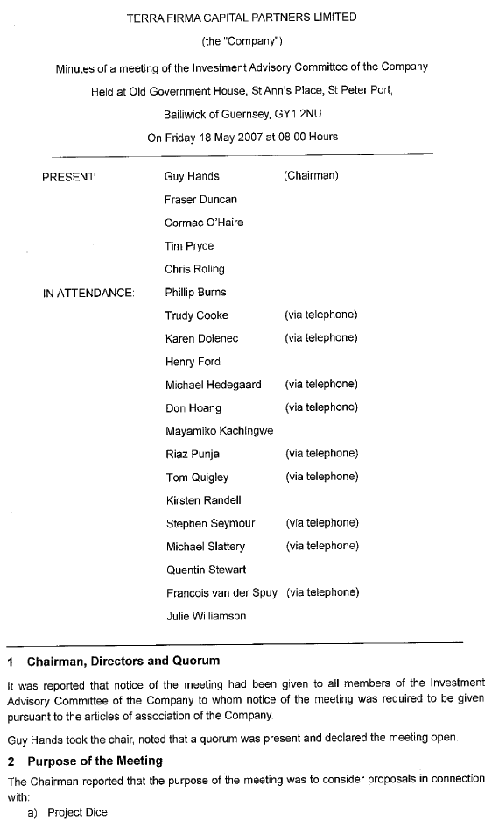



Terra Firma Was Consistently Targeting a Bid Price of 265p – May 18
Sunday | Monday | Tuesday | Wednesday | Thursday | Friday | Saturday
 |  | 1 | 2 | 3 | 4 | 5
6 | 7 | 8 | 9 | 10 | 11 | 12
13 | 14 | 15 | 16 | 17 | 18 | 19
20 | 21 | 22 | 23 | 24 | 25 | 26
27 | 28 | 29 | 30 | 31
May 2007
Bid Price: 265p
Bid Price: 265p
Bid Price: 265p
18
Bid Price: 265p
Bid Price: 265p
Bid Price: 265p
Bid Price: 265p
Bid Price: 265p

Slide 3
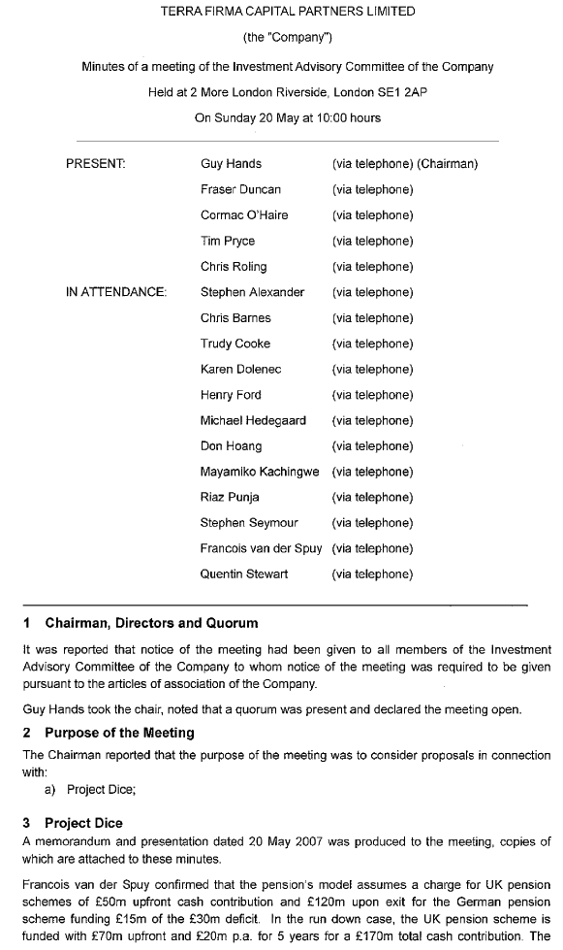


Terra Firma Was Consistently Targeting a Bid Price of 265p – May 20
Sunday | Monday | Tuesday | Wednesday | Thursday | Friday | Saturday
 |  | 1 | 2 | 3 | 4 | 5
6 | 7 | 8 | 9 | 10 | 11 | 12
13 | 14 | 15 | 16 | 17 | 18 | 19
20 | 21 | 22 | 23 | 24 | 25 | 26
27 | 28 | 29 | 30 | 31
May 2007
Bid Price: 265p
Bid Price: 265p
Bid Price: 265p
Bid Price: 265p
Bid Price: 265p
Bid Price: 265p
Bid Price: 265p
Bid Price: 265p
20
Bid Price: 265p

Slide 4
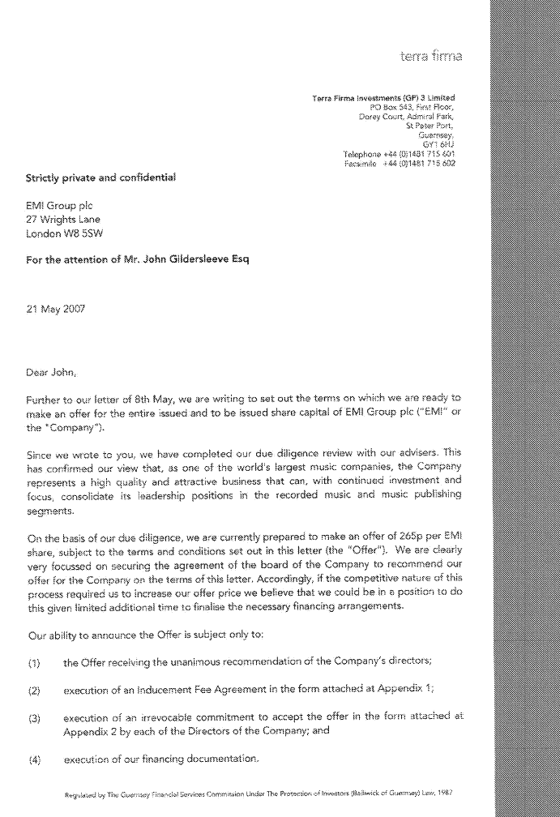


Terra Firma Was Consistently Targeting a Bid Price of 265p – May 21
Sunday | Monday | Tuesday | Wednesday | Thursday | Friday | Saturday
 |  | 1 | 2 | 3 | 4 | 5
6 | 7 | 8 | 9 | 10 | 11 | 12
13 | 14 | 15 | 16 | 17 | 18 | 19
20 | 21 | 22 | 23 | 24 | 25 | 26
27 | 28 | 29 | 30 | 31
May 2007
Bid Price: 265p
Bid Price: 265p
Bid Price: 265p
Bid Price: 265p
Bid Price: 265p
Bid Price: 265p
Bid Price: 265p
Bid Price: 265p
21
Bid Price: 265p
Bid Price: 265p

Slide 5
Terra Firma Was Consistently Targeting a Bid Price of 265p – May 21
Sunday | Monday | Tuesday | Wednesday | Thursday | Friday | Saturday
 |  | 1 | 2 | 3 | 4 | 5
6 | 7 | 8 | 9 | 10 | 11 | 12
13 | 14 | 15 | 16 | 17 | 18 | 19
20 | 21 | 22 | 23 | 24 | 25 | 26
27 | 28 | 29 | 30 | 31
May 2007
Bid Price: 265p
Bid Price: 265p
Bid Price: 265p
Bid Price: 265p
Bid Price: 265p
Bid Price: 265p
Bid Price: 265p
Bid Price: 265p
Bid Price: 265p
Bid Price: 265p

